Slide 1


UML DIAGRAM
Alpha 1137 – Team 4

Slide 2
Contents
Introduction
Building Blocks
UML Diagrams
Use-Case Diagram
Class Diagram
State Diagram
Sequence Diagram
Activity Diagram
Conclusion

Slide 3
Introduction
UML stands for Unified Modeling Language
UML is a standard language for specifying, visualizing, constructing and documenting the artifacts of software systems
UML has a direct relation with object oriented analysis and design
Programming-language independent
The goal of UML :Simple modeling mechanism to model all possible practical systems in today’s complex environment

Slide 4
Building Blocks
The building blocks of UML can be defined as:
Things
Relationships
Diagrams
Things are the most important building blocks of UML. They are:
Structural: Defines the static part
Behavioral: Defines the dynamic model
Grouping: Groups the elements
Annotational: To capture remarks
Relationship shows how elements are associated with each other and this association describes the functionality of an application

Slide 5

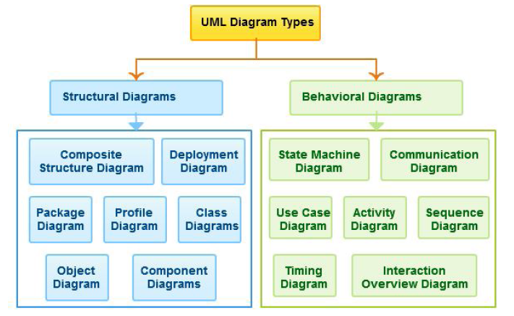
Building Blocks
There are three kinds of relationships available.
Dependency: Relationship between two things
Association: A set of links
Generalization: Connects specialized with a generalized element
Realization

Slide 6

UML Diagrams
Structural Diagrams:
Emphasize on the things that must be present in the system being modeled
Represents the framework for the system
Behavioural Diagrams:
Emphasize on what must happen in the system being modeled
Describe the functionality of software systems

Slide 7
UML Diagrams
Class diagram - classes, interfaces, associations and collaboration
Object diagrams - set of objects and their relationships
Component diagrams - set of components and their relationships
Deployment diagrams - set of nodes and their relationships
Use case diagram - relationships among the functionalities and their internal/external controllers
State chart diagram - responsible for state change of the system
Activity diagram - flow of control in a system

Slide 8
USE-CASE DIAGRAM

Slide 9
Use-Case Diagram
What is Use-Case Diagram?
Describes how interactions happen between User-System and System-Elements of system
Functional representation of a System
Specification of Higher level user goals that the system must perform
Why Use-Case Diagram?
Understanding of System Behavior
Predicting challenges in designing the Systems

Slide 10
Components
Actor – Mainly, who initiates the use-cases
Use-case – The higher level function user directly interacts with
Boundary – Defines the System
Links – Relationship between actors and use-cases

Slide 11
How to Draw a Use-Case Diagram
List main system functions (use cases) in a column
Draw ovals around the function labels
Draw system boundary
Draw actors and connect them with use cases
Specify include and extend relationships between use cases

Slide 12
Scenario - ATM Machine
Major functions in the ATM machine:
User interacting functions: -
Withdraw Cash
Check Balance
Deposit Funds
Transfer funds
Actors:
User
Secondary Actors:- Bank & Maintenance person

Slide 13
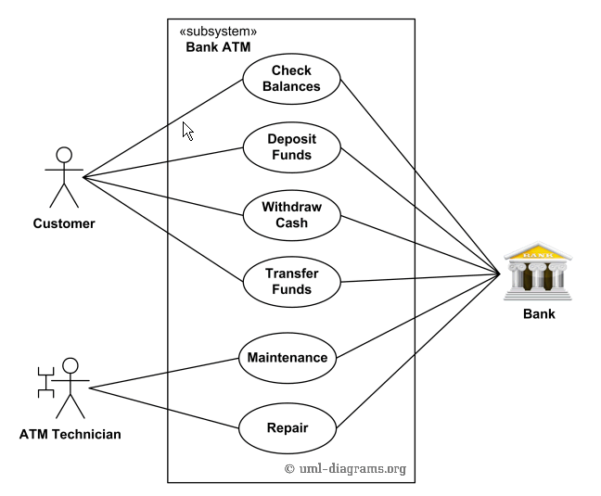
Use Case Diagram - ATM

Slide 14
CLASS DIAGRAM

Slide 15
Class Diagram
Represents the static view of an application
Collection of classes, interfaces, associations, collaborations and constraints
The class diagrams are widely used in the modelling of object oriented systems

Slide 16
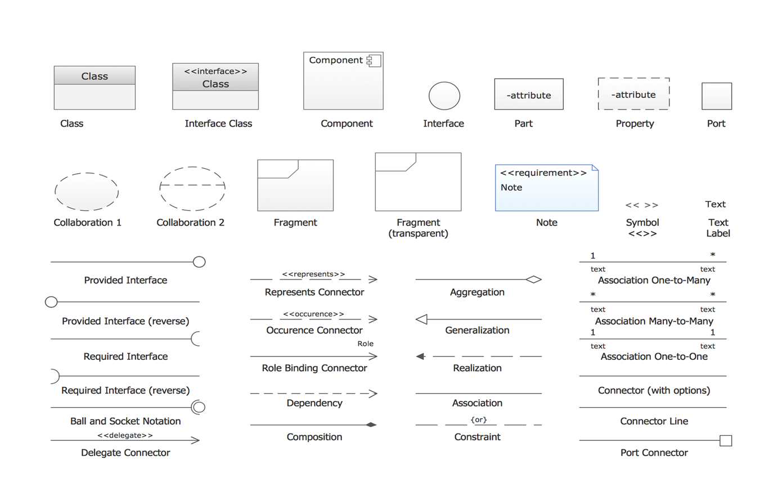
Class Diagrams - Notations

Slide 17
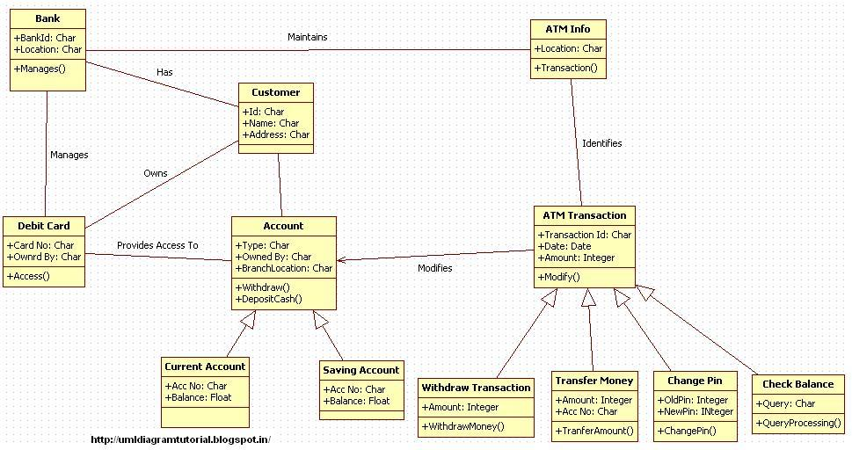
Class Diagram - ATM

Slide 18
STATE DIAGRAM

Slide 19
State Diagram
To model lifetime of an object from creation to termination
Graph with nodes and directed arcs
Dynamic behavior of the objects of the system
Specifies the state sequence caused by the event sequence

Slide 20
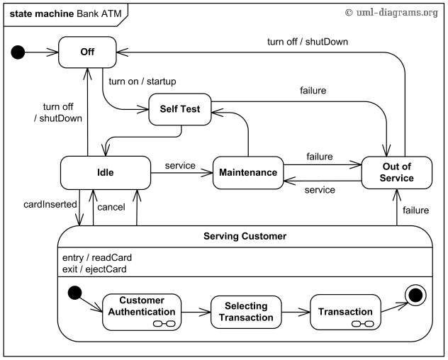
State Diagram - ATM

Slide 21
SEQUENCE DIAGRAM

Slide 22
Sequence Diagram
Describe the flow of messages, events, actions between objects
Show concurrent processes and activations
Show time sequences that are not easily depicted in other diagrams
Typically used during analysis and design to document and understand the logical flow of your system

Slide 23
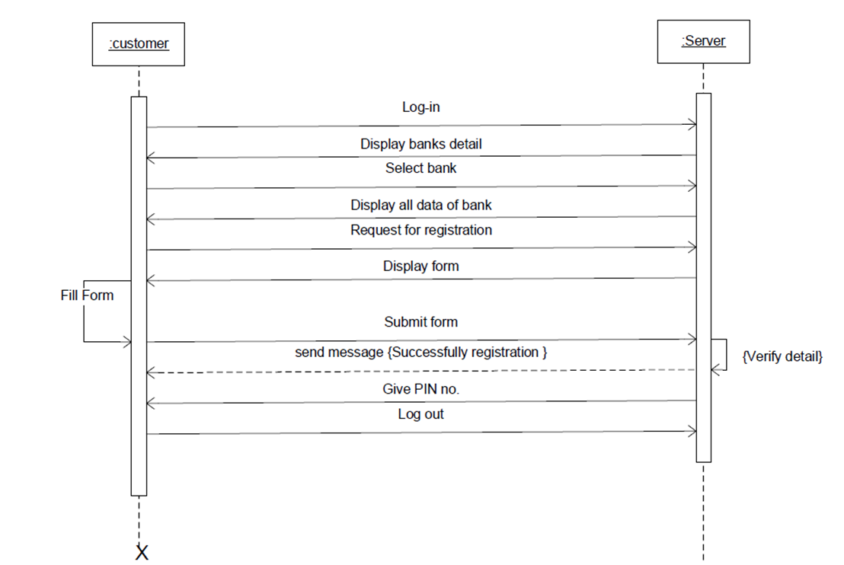
Sequence Diagram - ATM
CREATE ACCOUNT

Slide 24
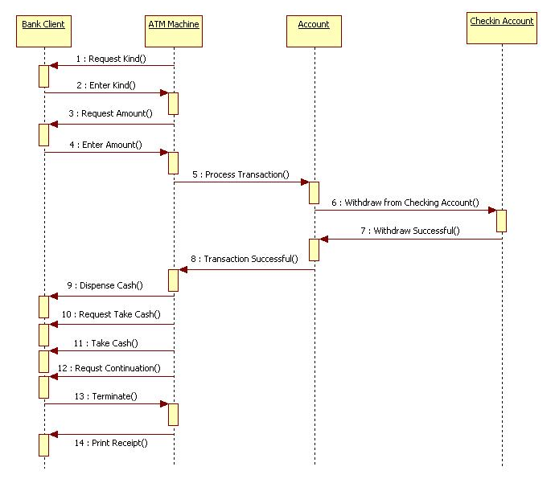
Sequence Diagram - ATM

Slide 25
ACTIVITY DIAGRAM

Slide 26
Activity Diagram
Flowchart to represent flow from one activity to another
Sequential, branched or concurrent
High level view of a system
More impact on business understanding rather than implementation details

Slide 27


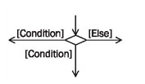



Activity Diagram - Notations
Initial Activity
Final Activity
Activity
Transition
Decision Node
Merge Node
Fork
Join

Slide 28
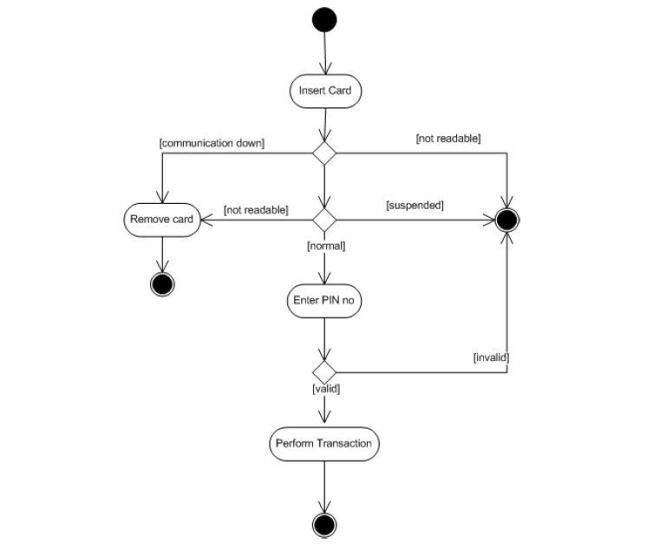
Activity Diagram - ATM
VERIFY PIN NUMBER

Slide 29
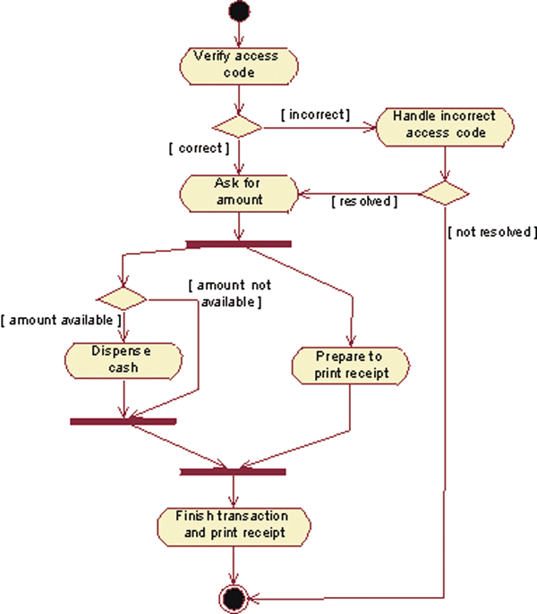
Activity Diagram - ATM
TRANSACTION

Slide 30
Conclusion
Powerful modeling Language
Independent of platform language
Easily understandable
Useful for maintenance of Enterprise projects

Slide 31


Slide 32


